Slide 1

INSIZE
Quality Innovation Service Value
Mechanical Assembly
INSIZE EUROPE S.L.
www.insize-eu.com
V.1 05.2026

Slide 2


CONTENTS
01
02
03
04
05
06
Dimensional Measurement
Installation And Commissioning
Surface Inspection
Torque Inspection
Mechanical Testing
Working Condition Inspection

Slide 3

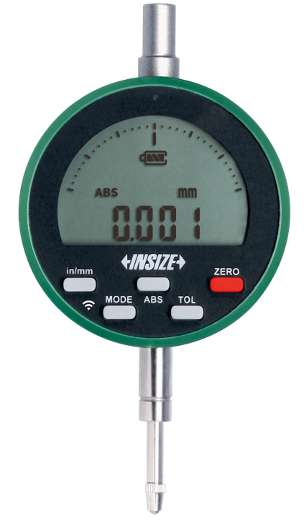
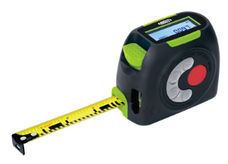
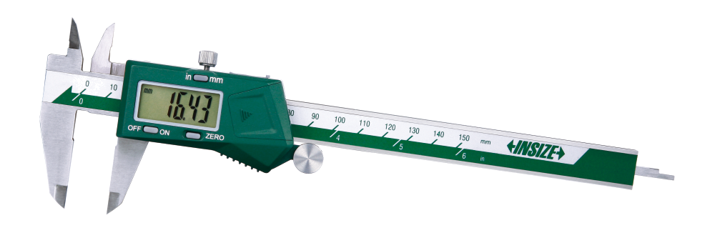
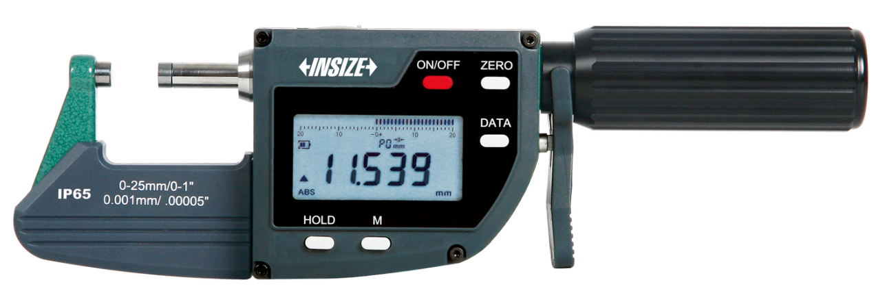
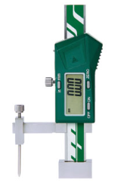
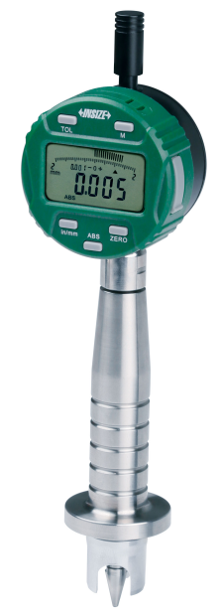
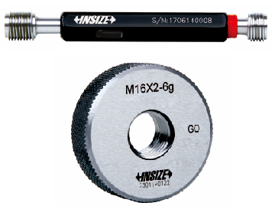
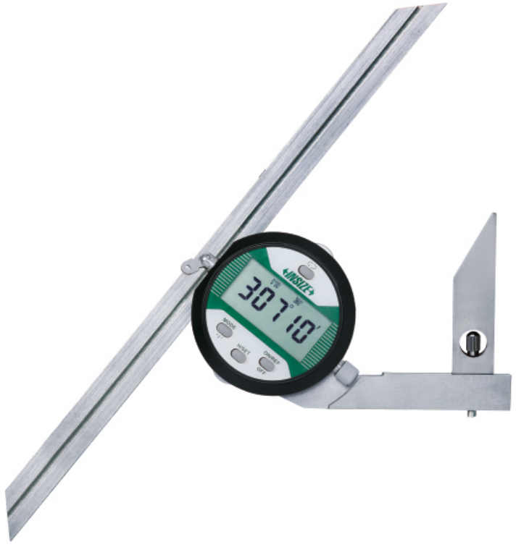
01
Dimensional Measurement (P1)
Digital Measuring Tapes
+ Laser Distance Meters
Digital Calipers
Digital Micrometers
Digital Indicators
Digital Height Gauges
Digital Flushness Gauges
Thread Ring/Plug Gauges
Digital Protractors

Slide 4
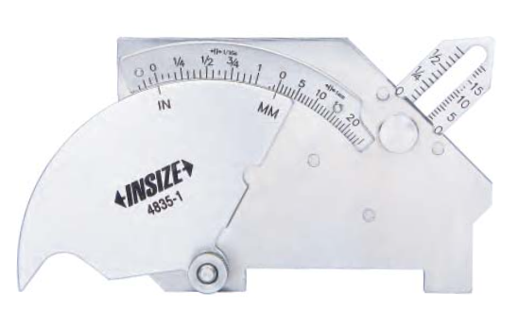
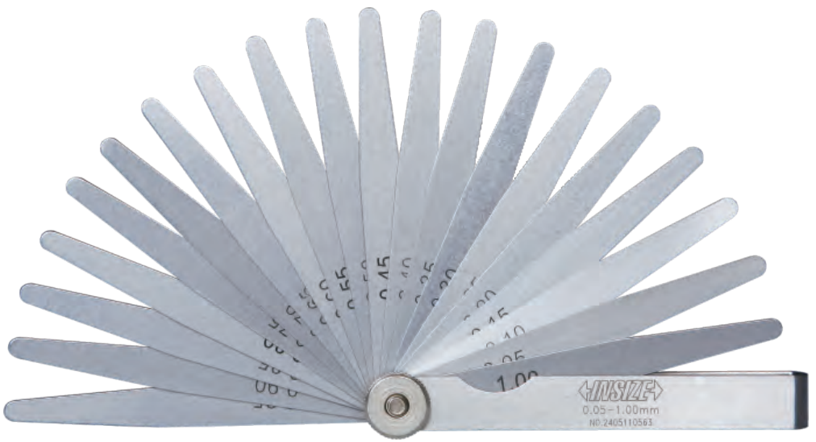
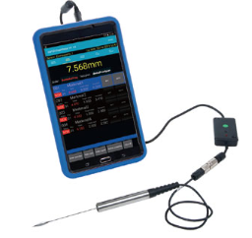
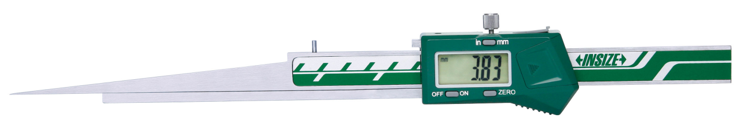
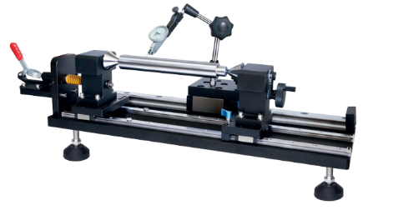
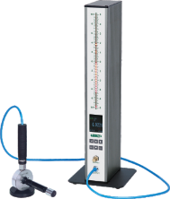
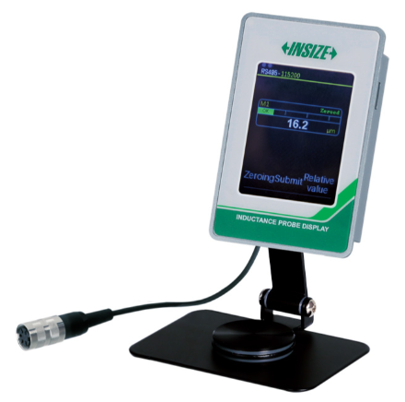
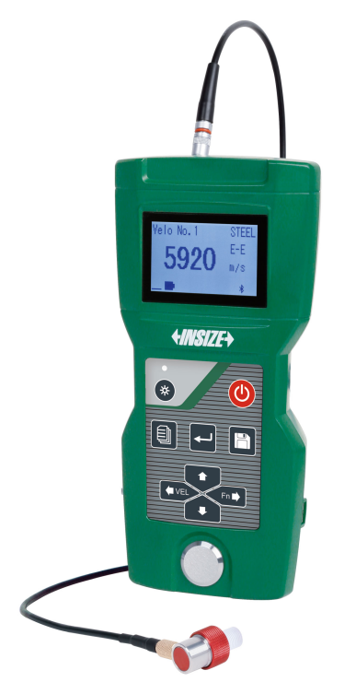
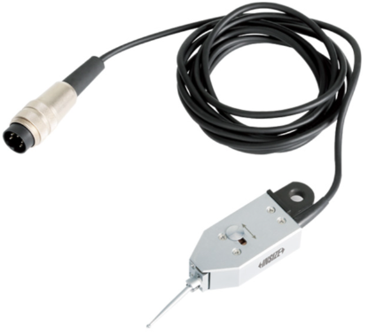
01
Dimensional Measurement (P2)
数显半径规
Digital Taper Slot Gauges
Digital Gap Gauges
Welding Gauges
Feeler Gauges
数显内卡规
键槽量具
Inductance Type Probes And Display Units
Bench Centers
Air Gauges And Displays
Ultrasonic Thickness Gauges

Slide 5
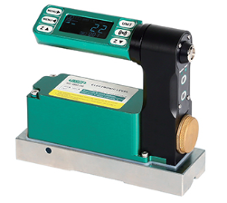
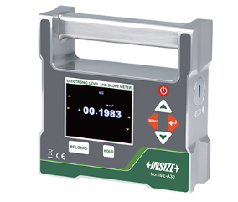
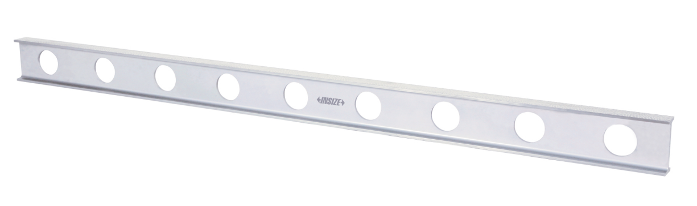
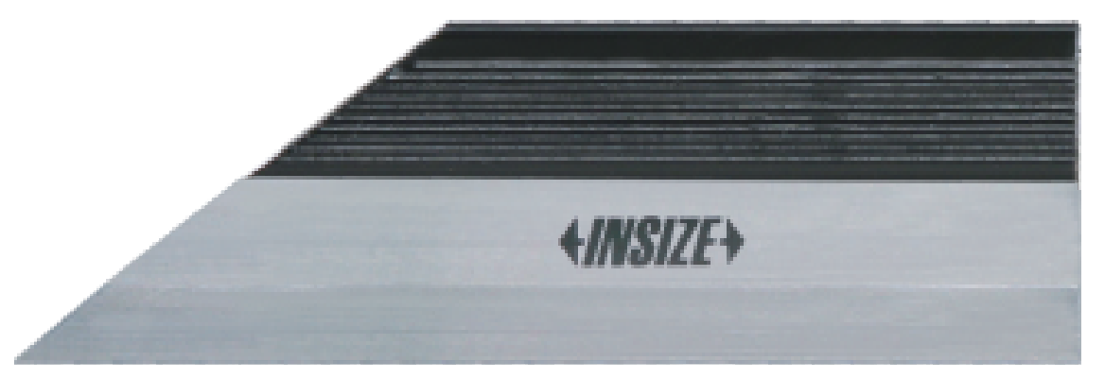
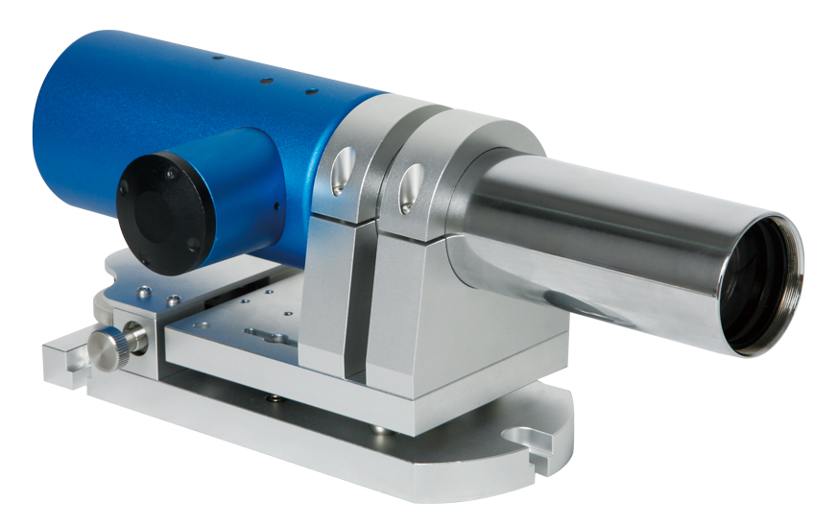
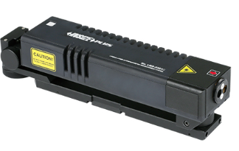
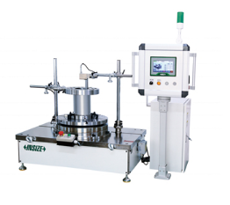
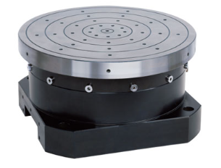
02
Installation And Commissioning
Straight Edges
Straight Edges
Digital Levels
Digital Inclination Levels
Dual Axis Photoelectric Autocollimators
Laser Interferometer Measurement Systems
Blade Runout Monitoring Stations
Air Floating Rotary Tables

Slide 6
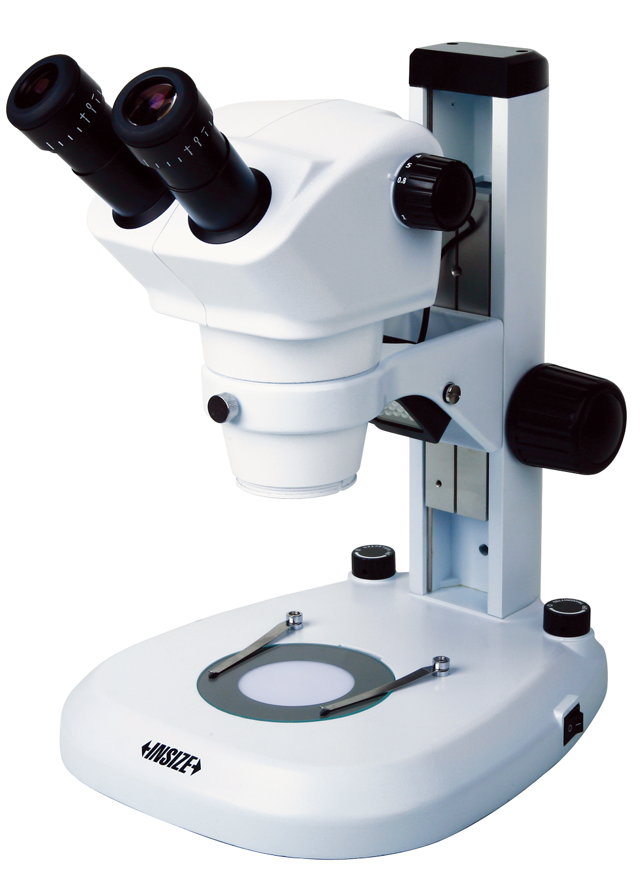
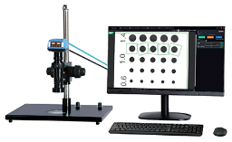
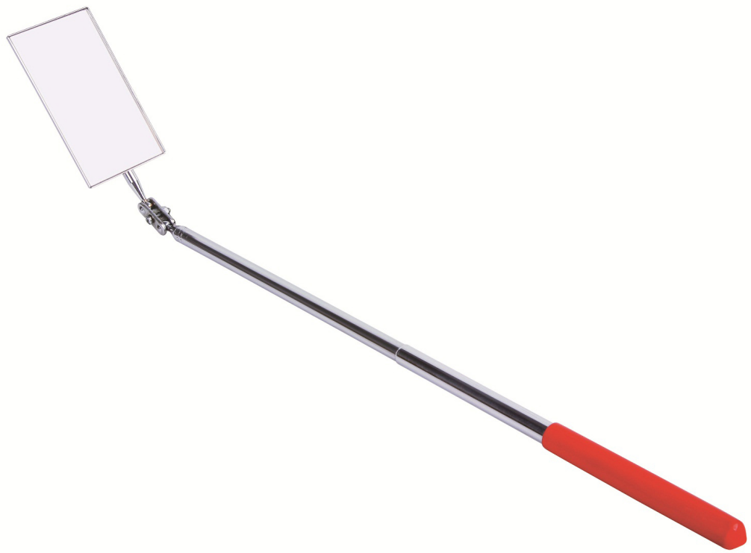
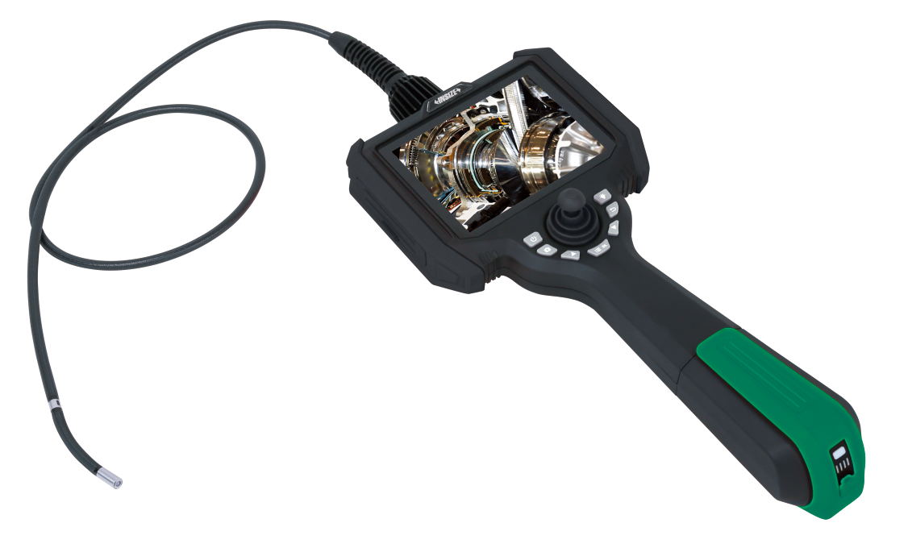
03
Surface Inspection
Zoom Stereo Microscopes
Smart Microscopes
Telescoping Inspection Mirrors
Videoscopes

Slide 7
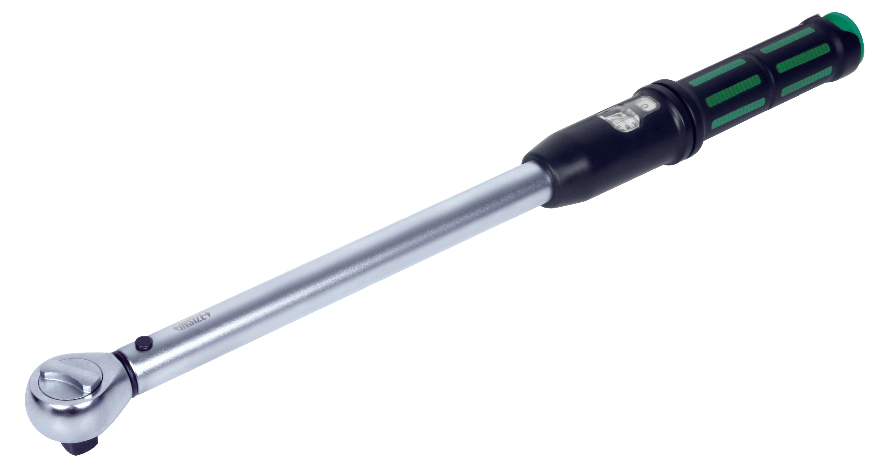
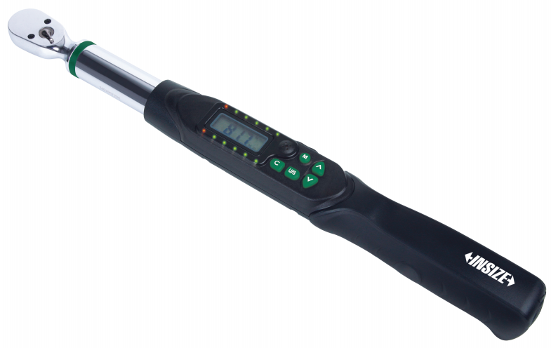
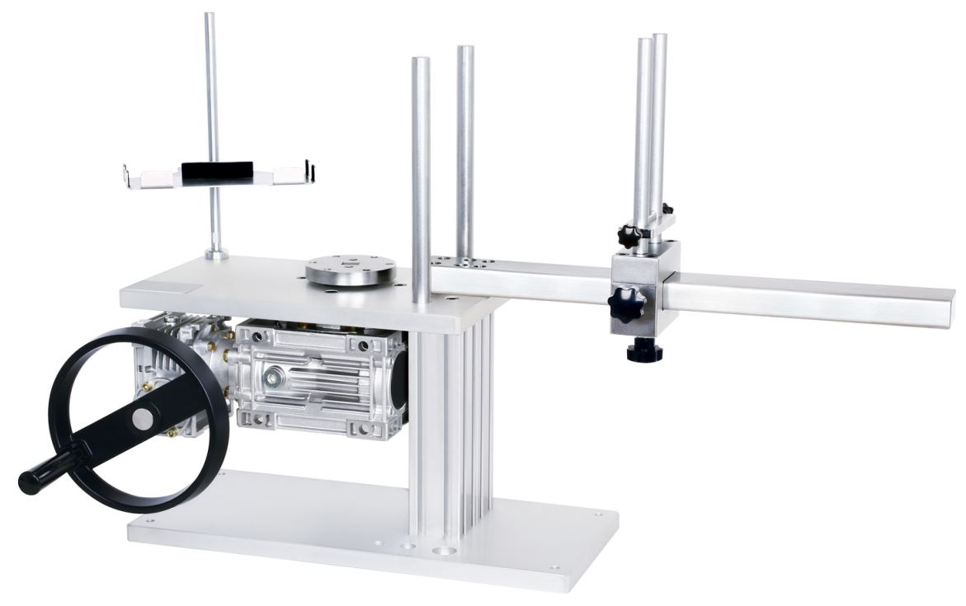
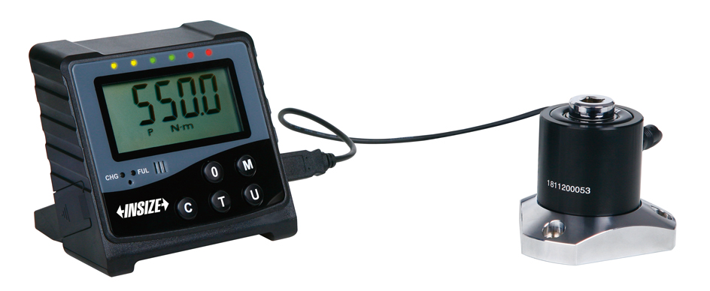
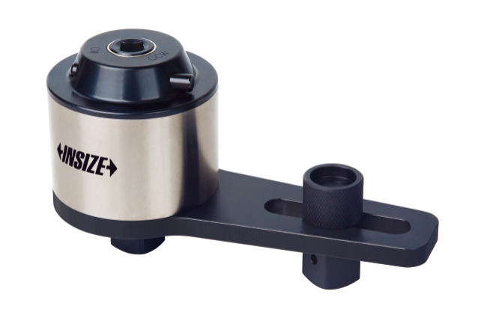
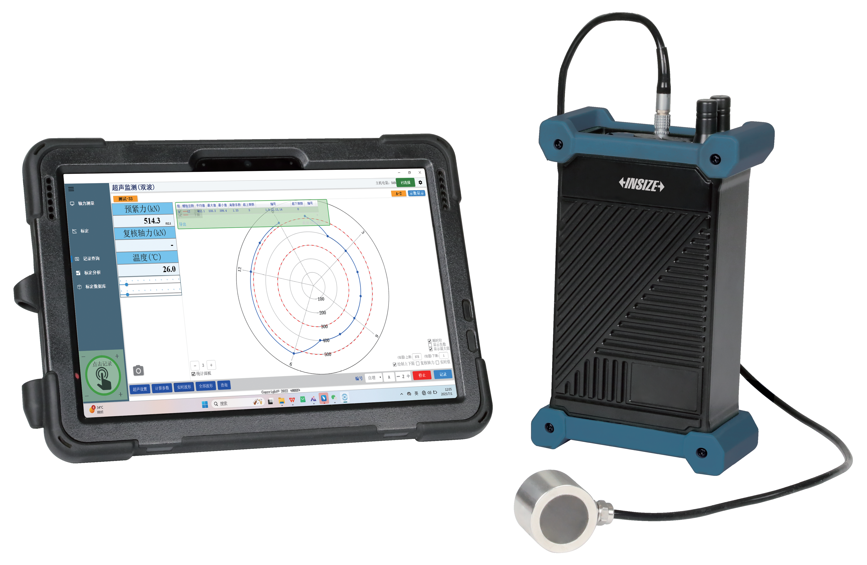
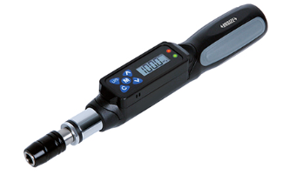
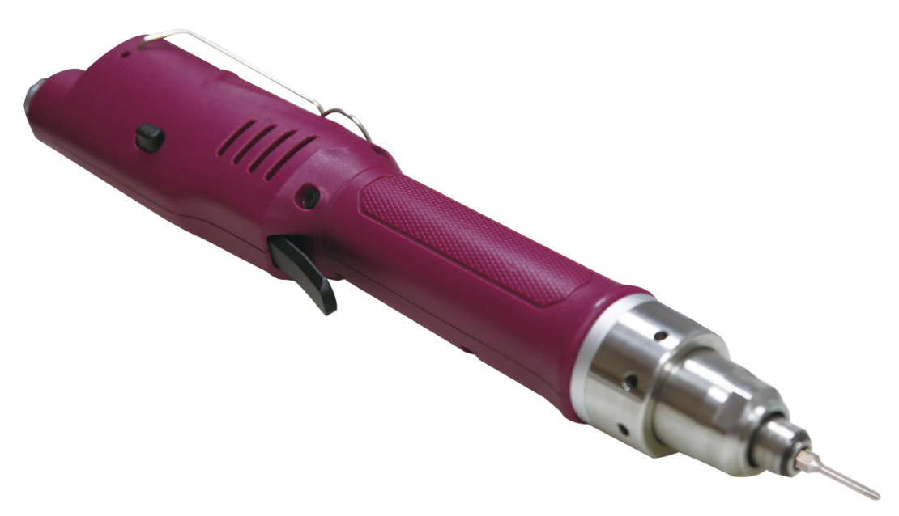
04
Torque Inspection
数显半径规
Digital Torque Testers
Torque Wrench Test Stands
Torque Wrenches
Digital Torque Wrenches
数显内卡规
键槽量具
Digital Torque Screwdrivers
Electric Screwdrivers
Torque Multipliers
Bolt Axial Force Testers

Slide 8
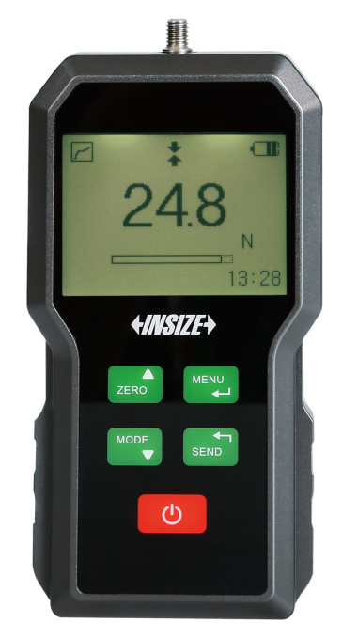
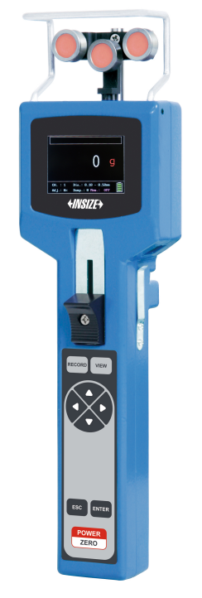
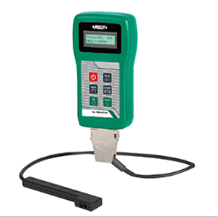
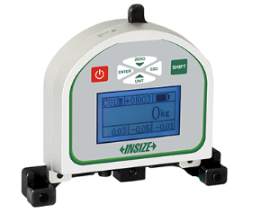
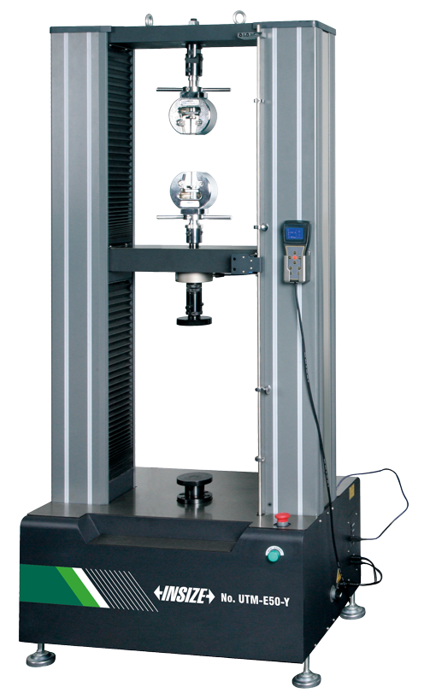
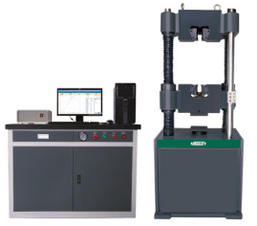
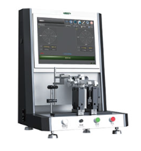
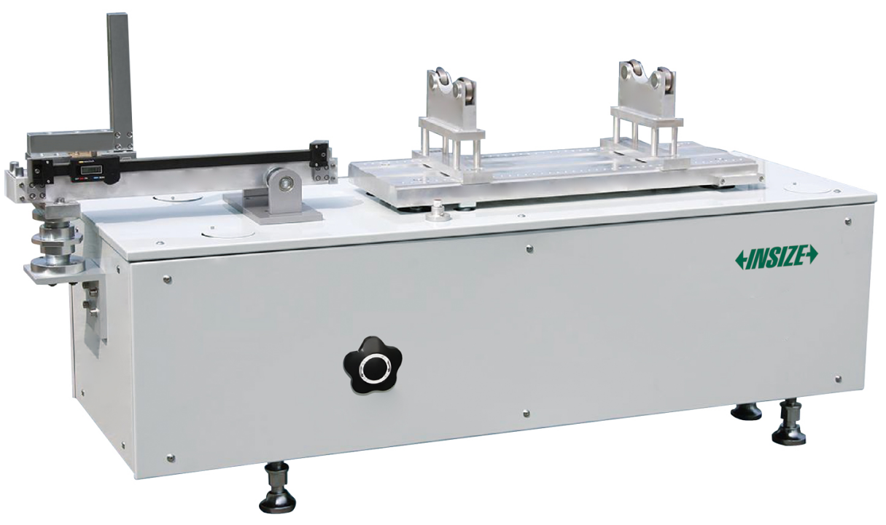
05
Mechanical Testing
数显半径规
Infrared Belt Tension Meters
Cable Tension Meters
Digital Force Gauges
Wire Tension Meters
数显内卡规
键槽量具
Electronic Universal
Testing Machines
Hydraulic Universal
Testing Machines
Horizontal Soft Bearing Balancing Machines
Horizontal Mass And Center Of Mass Testing Machines

Slide 9
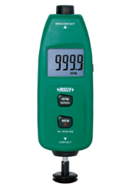
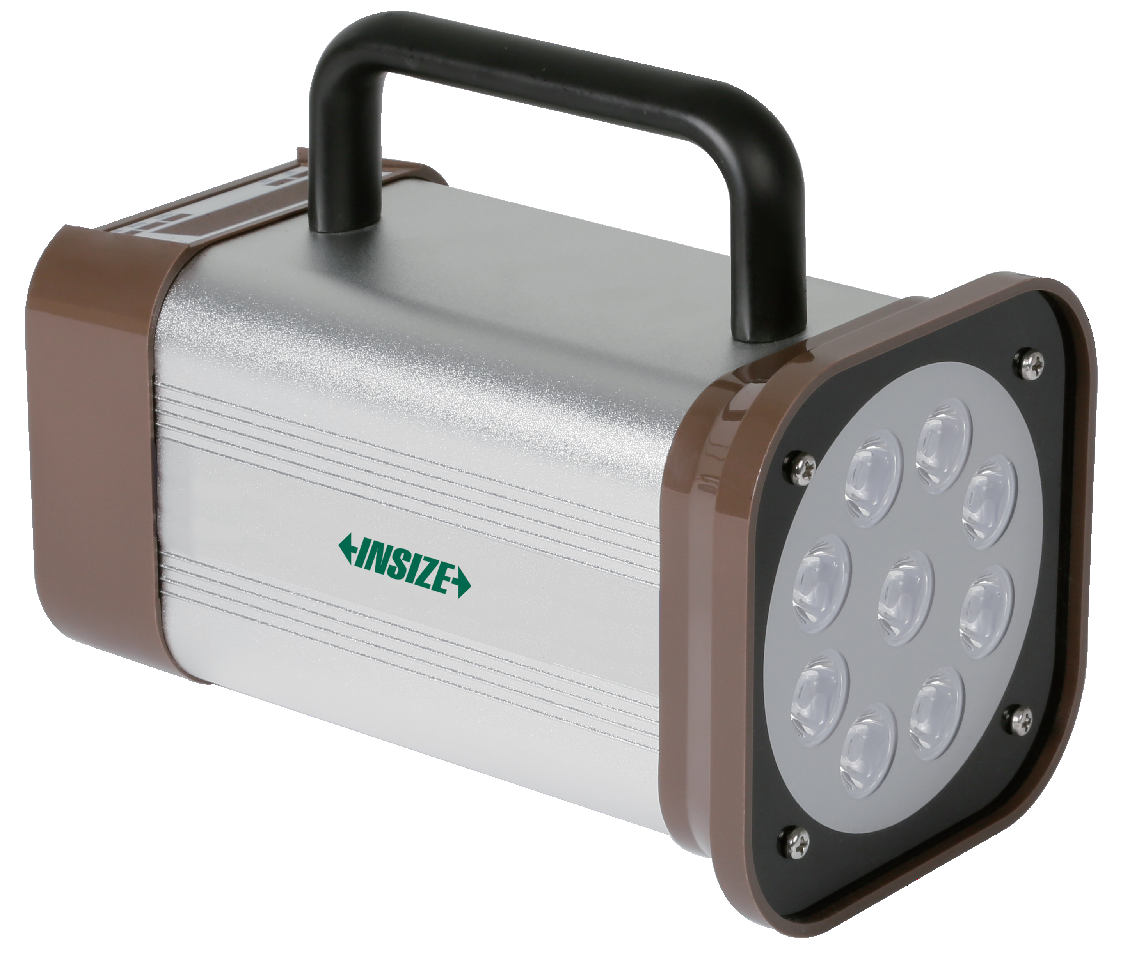
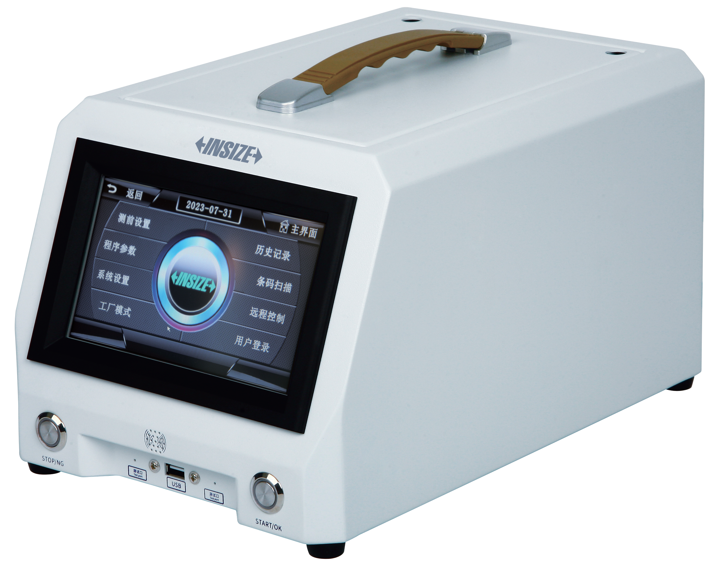
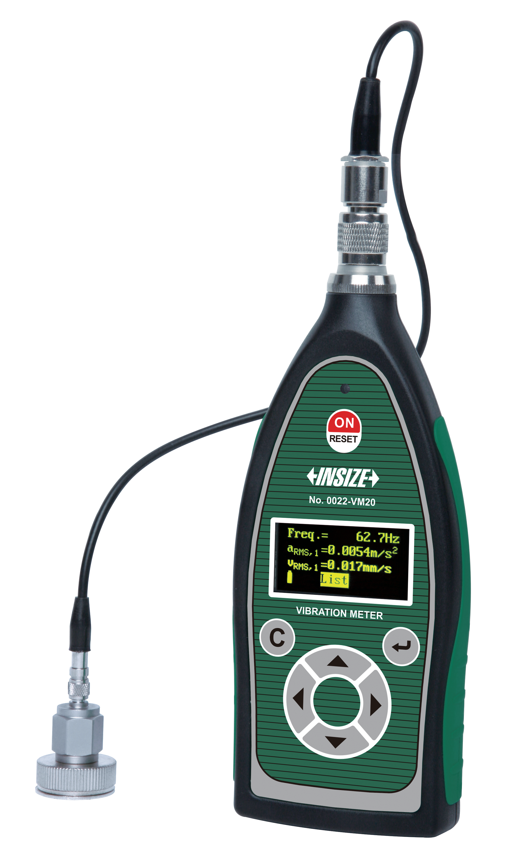
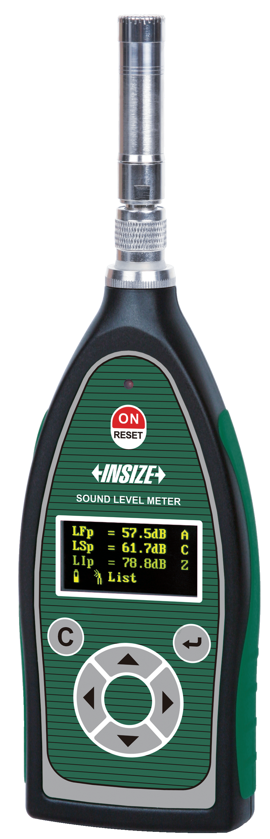




06
Working Condition Inspection
Air Leakage Testers
Tachometers
LED Stroboscopes
Vibration Meters
Sound Level Meters
Light Meters
Infrared Thermal Imaging Cameras
Thermohygrometers
Infrared Thermometers

